Slide 1
Analysis of Student course registration Aly6060: Decision support and business intelligence
Mayank Sharma
Northeastern university

Slide 2
Introduction
Dataset provided: Student course registration data
Consists of the information of the students registering for courses in different terms
Majorly focusing on registration prior to fall’16 or current fall’16 registration since there were course structure changes in fall’16
Analysis will be focused on courses offered in different terms on the basis of total enrollment
As well as the difficulty level of the courses prior or currently taught in fall’16

Slide 3
Dataset description
Dataset contains following attributes:
Course name – Name of the course
Course identification – All section of same course have same identification
CRN – Course record number (no sections have same CRN)
Priortofall16 – 0 for prior to fall’16 and 1 for taught in fall’16
Term – Semester course was taught
TotalEnrollment – Total number of students enrolled per section
NoGrade – No. of students with No grade/ Incomplete grade received
WithdrawOrFalilingGrade – No. of students withdrew or failed
PassingGrade – No. of students received passing grade

Slide 4
Business Question?
University is concerned with the students who did not studied the new structure of course. Since, the new structure has many new topics which are directly applied in the real world projects. Inclusion of these topics in the course structure will help students to fetch job easily and also help students who are planning to pursue a higher degree in future.
Therefore, university wants to know whether students are finding the new structure difficult or easy.

Slide 5
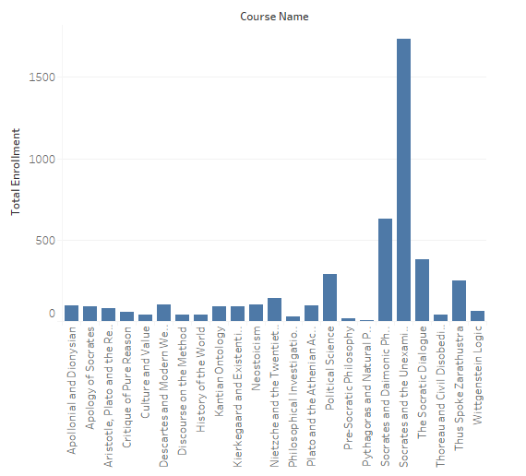
Total enrollment according to courses

Slide 6
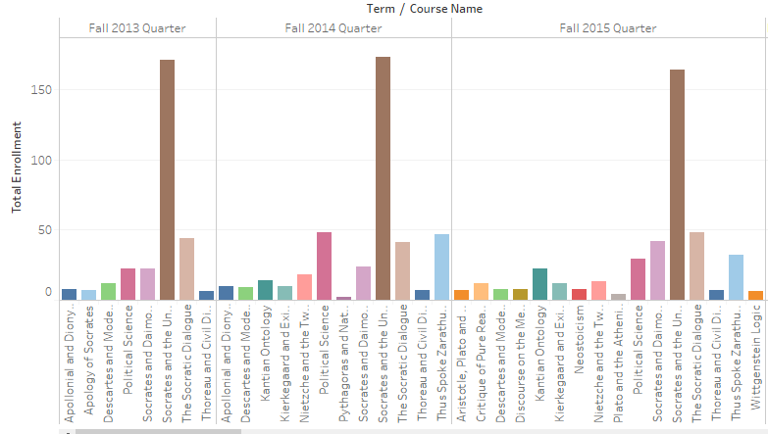
Total enrollment according to different terms

Slide 7
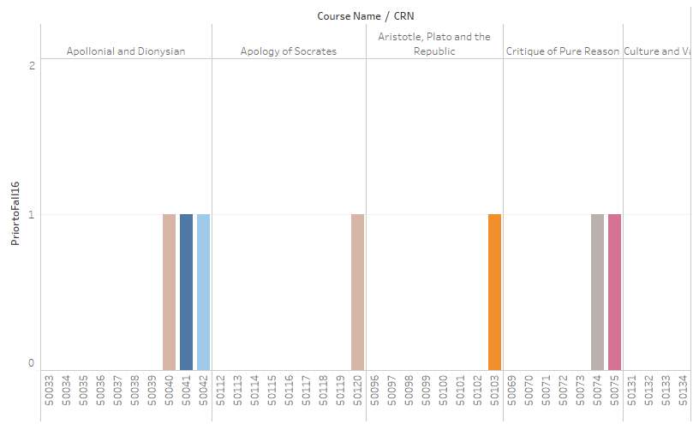
Subjects taught prior or currently in fall’16

Slide 8
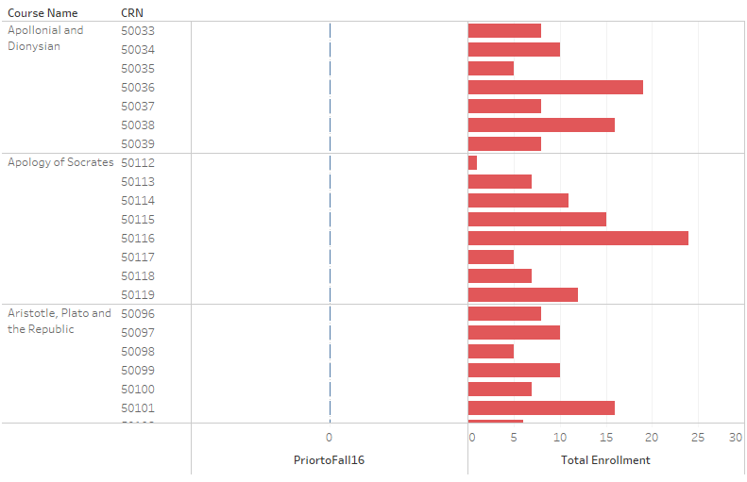
CRn taught prior to fall’16

Slide 9
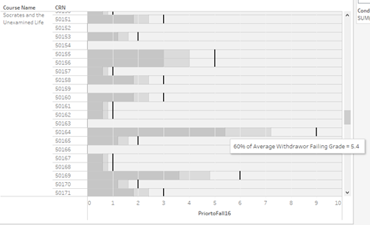
Average students failing prior to fall’16

Slide 10
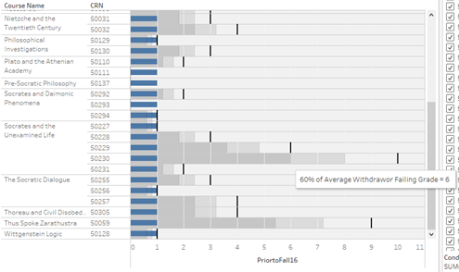
Average students failing rate increases in fall’16

Slide 11
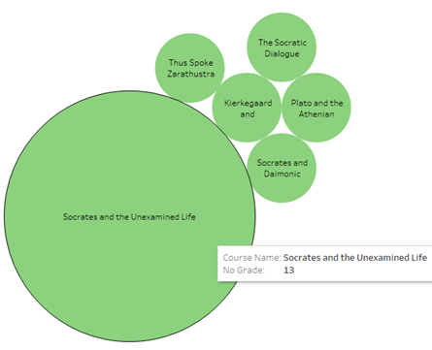
No. of students with no grades with course names

Slide 12

No. of students who withdrew of failed In particular course

Slide 13
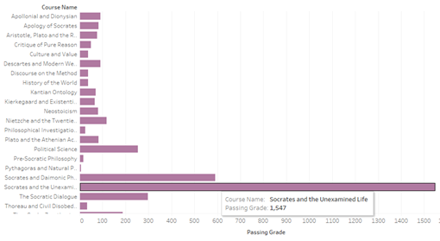
No. of students having passing grades in different courses

Slide 14
Conclusion
Answer to business question:
Since the failing grade for most of students is less in semesters before fall’16 and more is fall’16, we can conclude that the new structure is difficult for students.
Other insights and advice to the university:
Three courses with most number of enrollment
1. Socrates and unexpected life (1733)
2. Socrates and daimonic phenomenon (632)
3. the socratic dialogue (380)
Since, the enrollment in most of the courses is almost same except few courses, university should focus on changing the course material in other courses which can lead to increase in total enrollment.

Slide 15
References
ttDataVis: How to create interactive dashboards with tableau public http://www.ttdatavis.onthinktanks.org/how-tos/how-to-create-interactive-dashboards-with-tableau-public
Tableau: Tableau Desktop and Tableau Prep Deployment Guide Overview https://onlinehelp.tableau.com/current/desktopdeploy/en-us/desktop_deploy_welcome.htm

